Slide 1

2016 Shelby County Women’s CONFERENCE

Slide 2

2016 Shelby County Women’s CONFERENCE

Slide 3
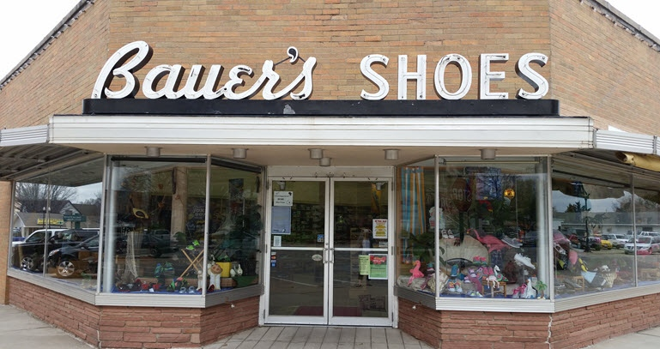
2016 Shelby County Women’s CONFERENCE Sponsor
Celebrating 90 years of Service

Slide 4

2016 Shelby County Women’s CONFERENCE Sponsor

Slide 5
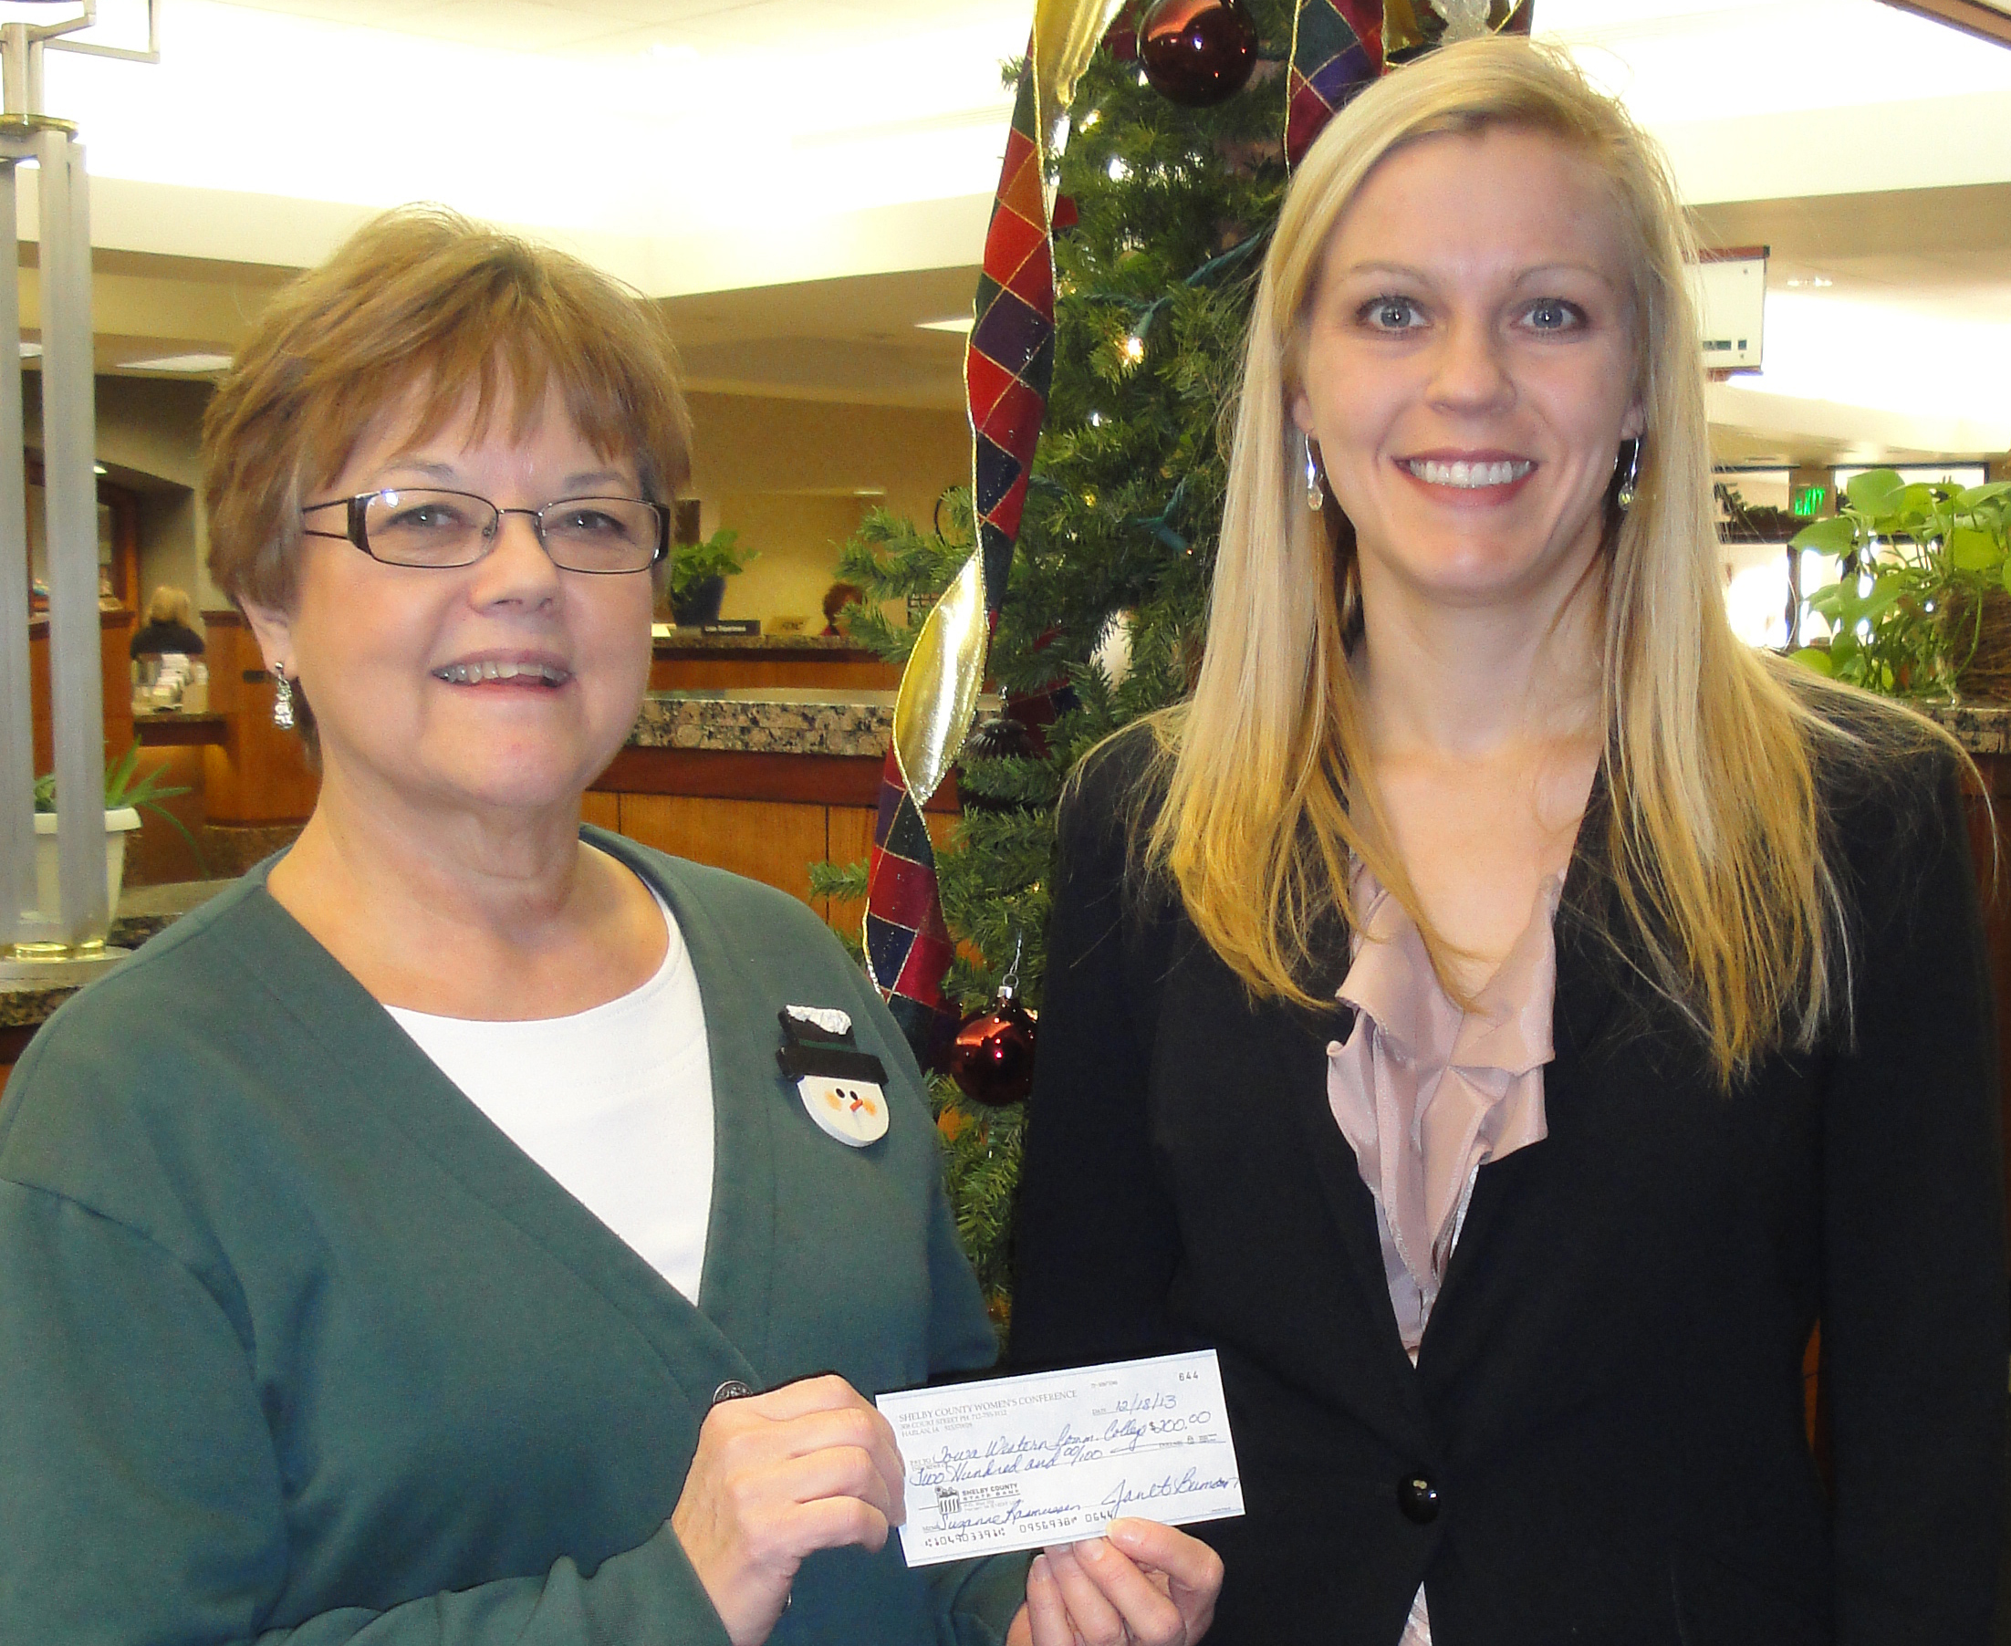
2016 Shelby County Women’s CONFERENCE Memories
Scholarship Recipient – Suzanne Rassmussen

Slide 6

2016 Shelby County Women’s CONFERENCE Sponsor

Slide 7

2016 Shelby County Women’s CONFERENCE Sponsor

Slide 8
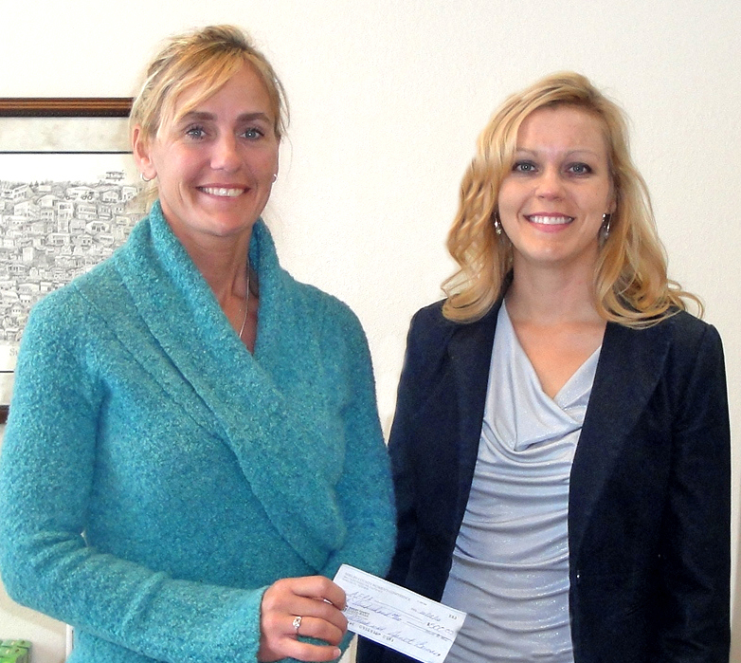
2016 Shelby County Women’s CONFERENCE Memories
Scholarship Recipient

Slide 9
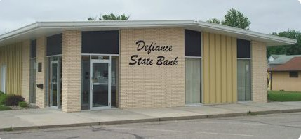
2016 Shelby County Women’s CONFERENCE Sponsor

Slide 10

2016 Shelby County Women’s CONFERENCE Sponsor

Slide 11
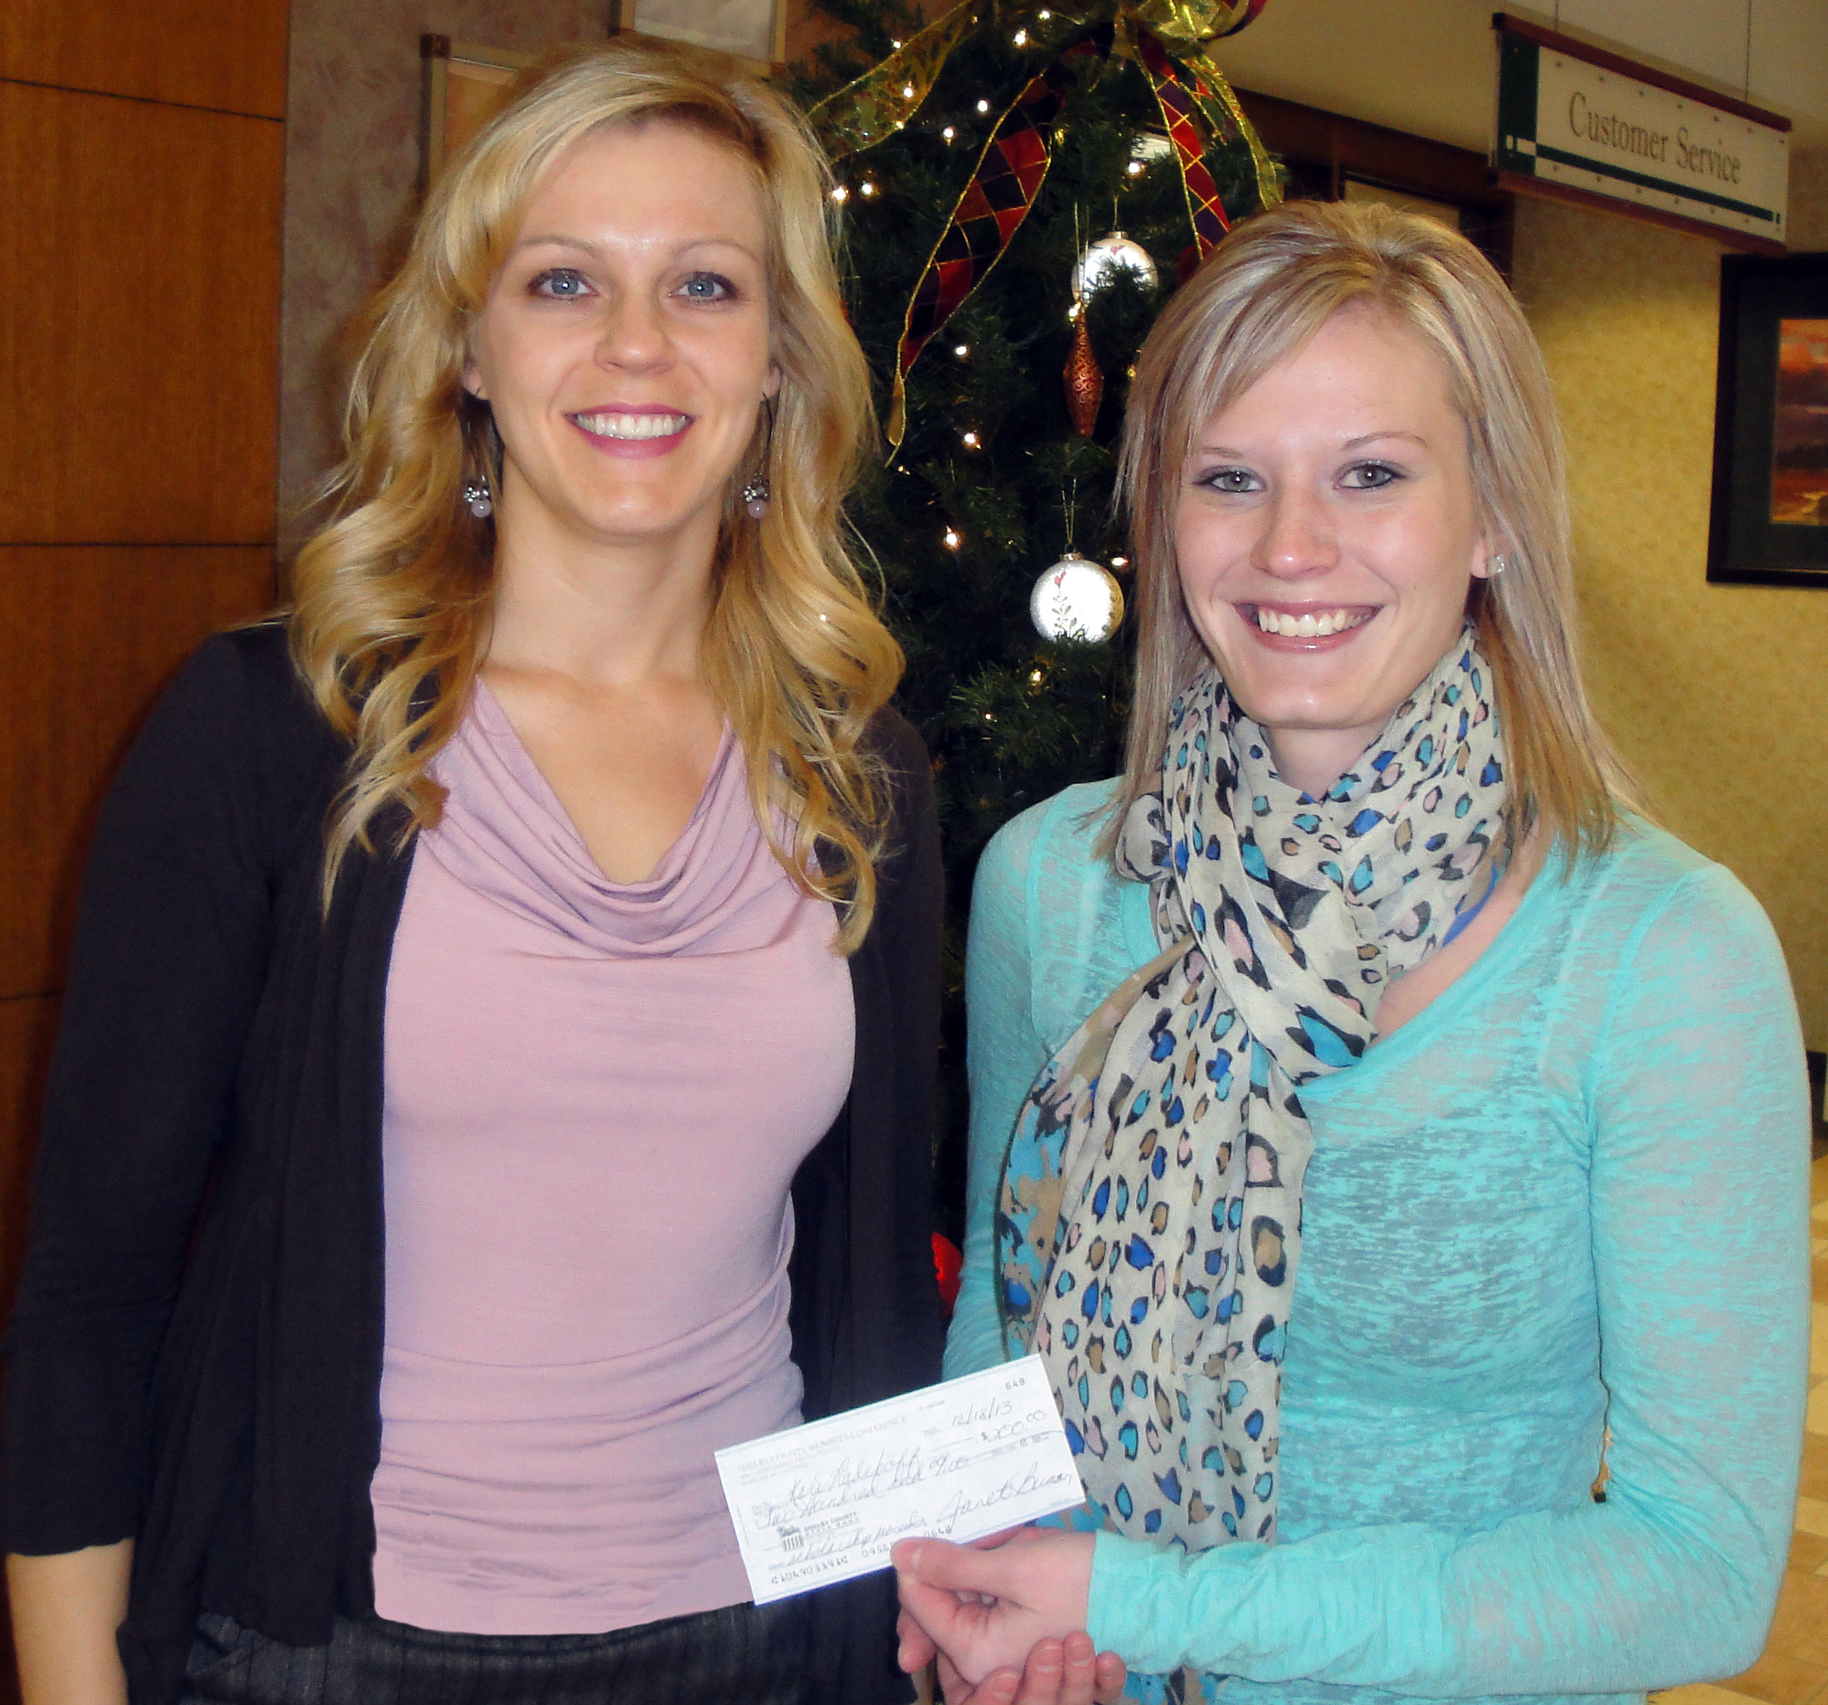
2016 Shelby County Women’s CONFERENCE Memories
Scholarship Recipient – Kari Ladehoff

Slide 12

2016 Shelby County Women’s CONFERENCE Sponsor

Slide 13

2016 Shelby County Women’s CONFERENCE Sponsor

Slide 14
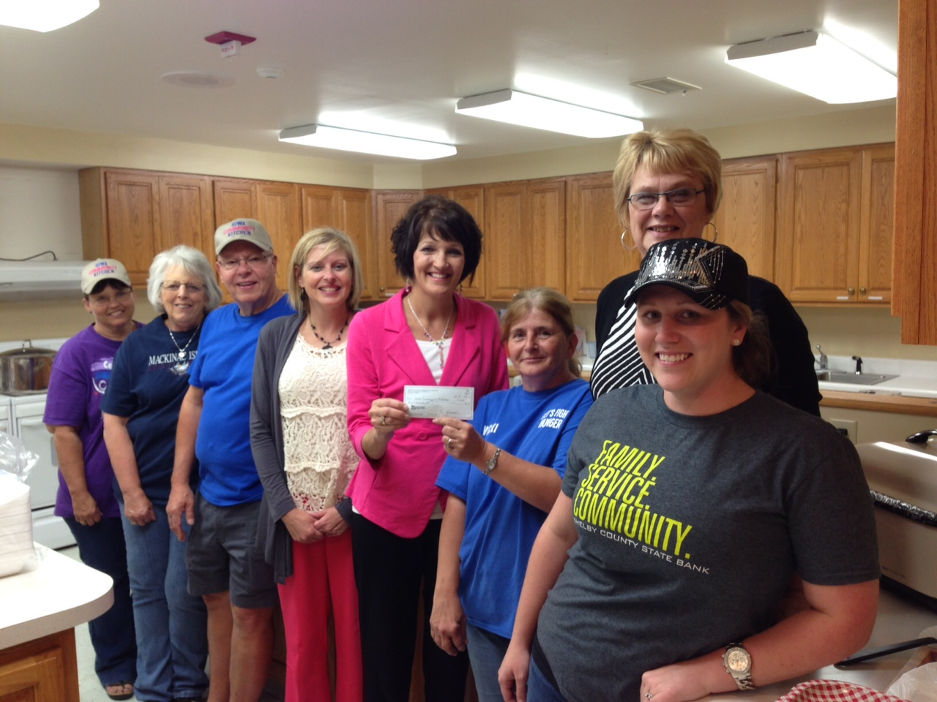
2016 Shelby County Women’s CONFERENCE Memories
Giving Back to Shelby County – Iowa Community Kitchen

Slide 15

2016 Shelby County Women’s CONFERENCE Sponsor

Slide 16

2016 Shelby County Women’s CONFERENCE Sponsor

Slide 17
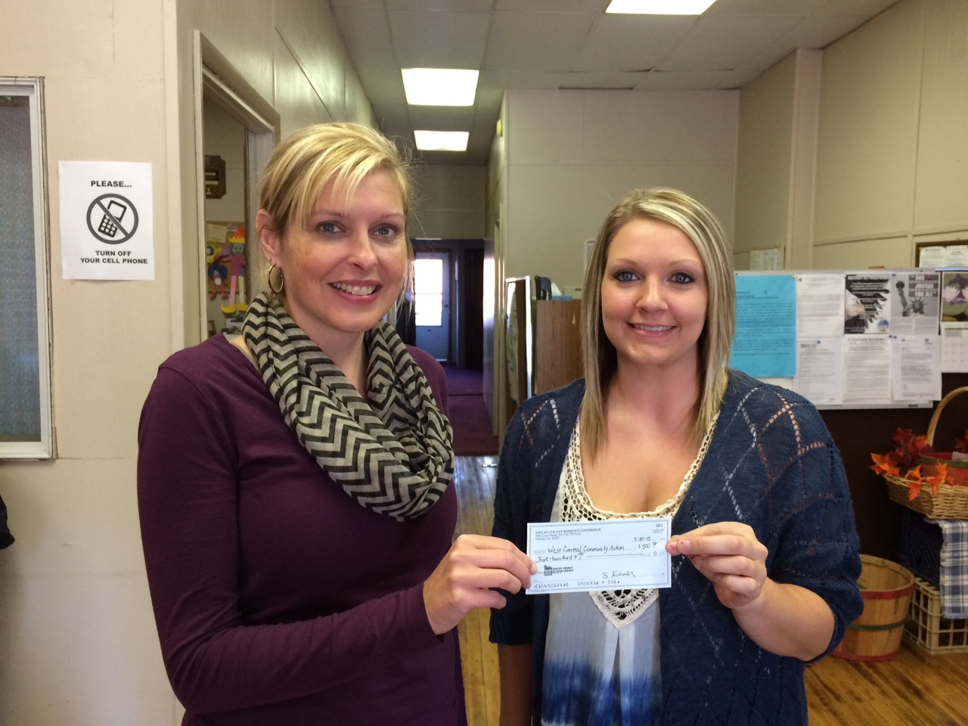
2016 Shelby County Women’s CONFERENCE Memories
Giving Back to Shelby County – West Central Community Action Food Pantry

Slide 18

2016 Shelby County Women’s CONFERENCE Sponsor

Slide 19
2016 Shelby County Women’s CONFERENCE Sponsor
Celebrating 50 Years of Service

Slide 20

2016 Shelby County Women’s CONFERENCE Memories
2015 Keynote Speaker Sheree Clark from Fork in the Road

Slide 21

2016 Shelby County Women’s CONFERENCE Sponsor

Slide 22

2016 Shelby County Women’s CONFERENCE Sponsor

Slide 23
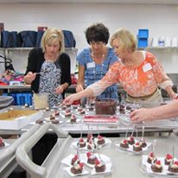
2016 Shelby County Women’s CONFERENCE Memories
Conference committee members preparing food

Slide 24
2016 Shelby County Women’s CONFERENCE Sponsor
Lifestyle Marketing

Slide 25

2016 Shelby County Women’s CONFERENCE Sponsor

Slide 26
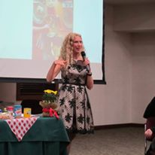
2016 Shelby County Women’s CONFERENCE Memories
2015 Keynote Speaker Sheree Clark from Fork in the Road

Slide 27

2016 Shelby County Women’s CONFERENCE Sponsor

Slide 28

2016 Shelby County Women’s CONFERENCE Sponsor

Slide 29
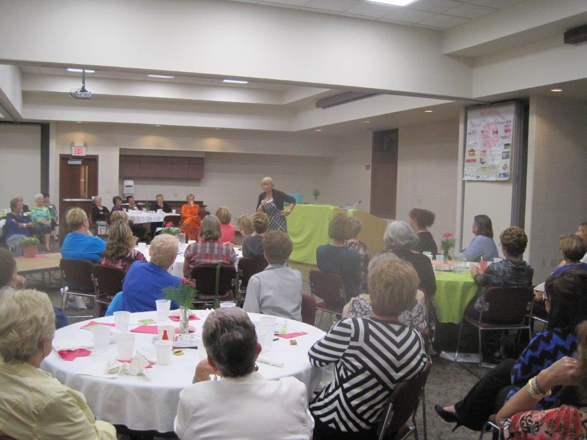
2016 Shelby County Women’s CONFERENCE Memories
2014 Keynote speaker Brenda Elsagher

Slide 30

2016 Shelby County Women’s CONFERENCE Sponsor

Slide 31

2016 Shelby County Women’s CONFERENCE Sponsor

Slide 32

2016 Shelby County Women’s CONFERENCE Memories
SCWC Past Theme

Slide 33

2016 Shelby County Women’s CONFERENCE Sponsor

Slide 34

2016 Shelby County Women’s CONFERENCE Sponsor

Slide 35

2016 Shelby County Women’s CONFERENCE Memories
SCWC Past Theme

Slide 36

2016 Shelby County Women’s CONFERENCE Sponsor

Slide 37

2016 Shelby County Women’s CONFERENCE Sponsor

Slide 38

2016 Shelby County Women’s CONFERENCE Memories
SCWC Past Theme

Slide 39

2016 Shelby County Women’s CONFERENCE Sponsor

Slide 40

2016 Shelby County Women’s CONFERENCE Sponsor

Slide 41

2016 Shelby County Women’s CONFERENCE Sponsor
2014 Scholarship Winners

Slide 42

2016 Shelby County Women’s CONFERENCE Sponsor

